Slide 1

Introduction to Python libraries for Machine learning

Slide 2
Speaker Introduction
I am Aryan Pareek, a third year undergraduate student at Techno India University, Kolkata.
ML, AI and Computer Vision enthusiast. ML track facilitator at GDSC TIU.
Currently exploring research ideas in Image Segmentation using deep learning libraries like fastai.

Slide 3
Agenda for the session
1. Introduction on Python.
2. Use in various fields, utility and scope of implementation.
3. Introduction to numpy, pandas and their functions for ML.
4. Introduction to matplotlib and graphing in Python.
5. Brief show of personal projects that depend on numpy and matplotlib.
6. Q&A.

Slide 4
Introduction on Python.
Python is a general-purpose, high level programming language. It was created by Guido van Rossum in 1991 and further developed by the Python Software Foundation.
Lay emphasis on code readability.
Express more concepts in fewer lines of code.

Slide 5
“Python is an experiment in how much freedom programmers need. Too much freedom and nobody can read another's code; too little and expressiveness is endangered.”- Guido van Rossum.

Slide 6
Why use Python for ML?
Low-entry barrier.
Flexibility.
Platform Independence.
Readability.
Visualization (matplotlib)
Community support. (Open-source)
Growing popularity.
Rich library system. (Most important and our main agenda for the day)

Slide 7
Low entry barrier. Quickly pick up Python and start using it for development without wasting too much time learning the language.
Readability. Developers need to implement several small-scale changes and modify some lines of code to create an executable form of code for the platform.
Community Support. Programmers and ML developers discuss errors, solve problems, and help each other. Python is absolutely free as is the variety of useful libraries and tools.
A great library ecosystem. ML requires continuous data processing, and Python’s libraries let you access, handle and transform data.
The libraries that we will explore in today’s lesson are:
Numpy, matplotlib and pandas(optional).

Slide 8
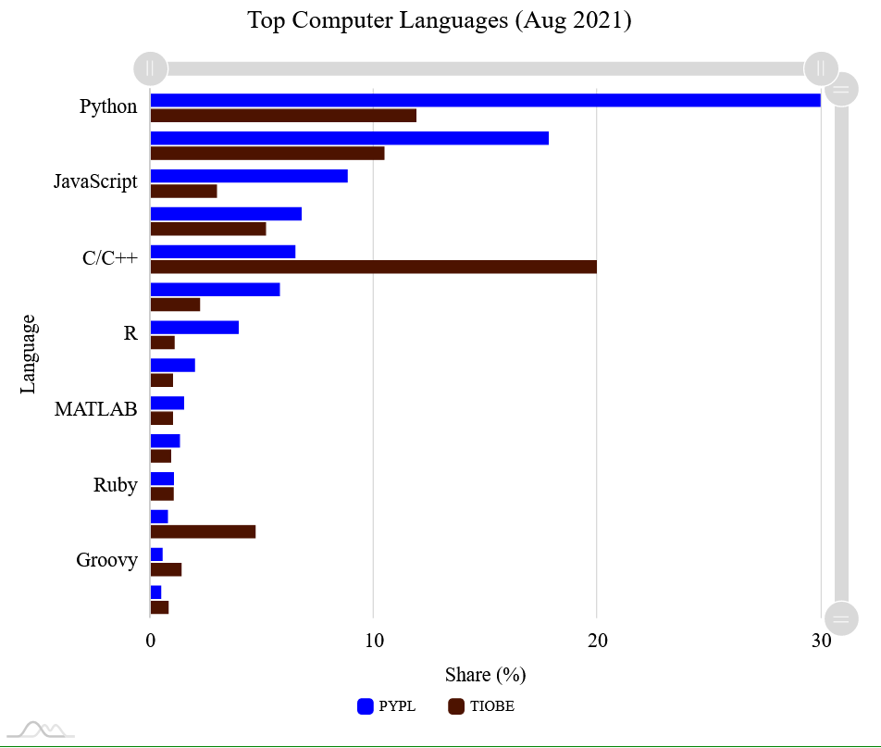
Python continues to be the most commonly used language globally. (as of 11th August 2021).
The main reason being that Python is the most diverse language on the planet.
Its domains are:
Website Development
Task automation
Data Science
Machine Learning
Artificial Intelligence, Deep Learning
Computer Vision

Slide 9
What is Python library?
Python library is a collection of functions and methods that allows you to perform many actions without writing your code.
Purpose of these libraries is that you do not write the entire code from the beginning.
Automatically provide you some inbuilt functions which you can use to make your work easier.

Slide 10
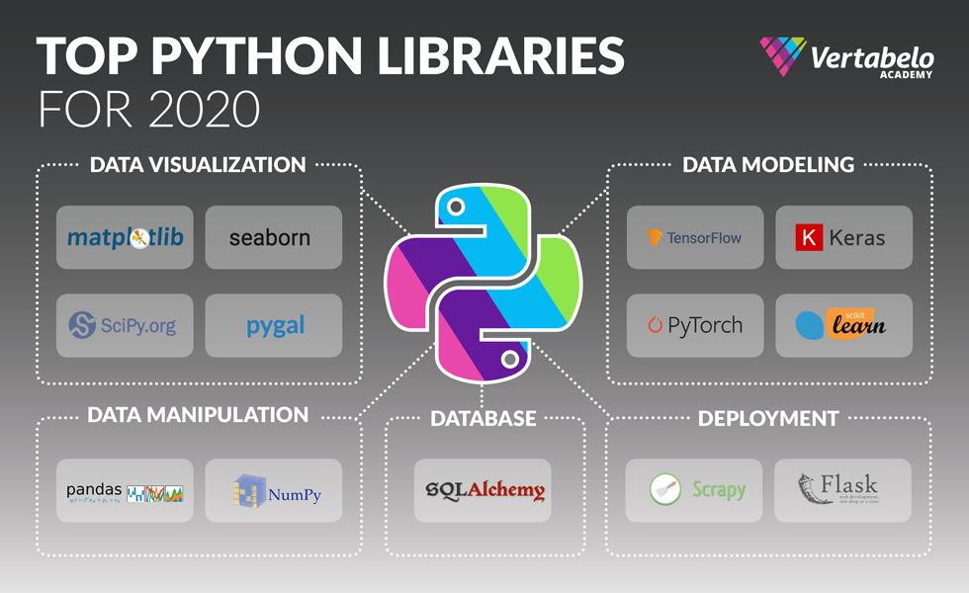
Libraries in Python and their area of deployment

Slide 11
What is NumPy in Python?
NumPy stands for Numerical Python.
It is the core library for numeric and scientific computations.
First developed in 2005.
Open-source just like the rest of Python.
It consists of multi-dimensional array objects and a collection of routines for processing those arrays.

Slide 12
How to start and where to code?
Students face setup problems.
Avoid them by using Google’s Colab.
Colaboratory, or "Colab" for short, allows you to write and execute Python in your browser, with
Zero configuration required.
Easy sharing.
Free access to GPUs and TPUs.

Slide 13
What is pandas in Python?
Pandas stands for Panel Data.
It is the core library for data manipulation and data analysis.
Open-source just like the rest of Python.
It consists of single and multi-dimensional data structures for data manipulation and a collection of routines for processing those structures.

Slide 14
What is matplotlib library in Python?
Matplotlib is a cross-platform, data visualization and graphical plotting library for Python and its numerical extension NumPy.
matplotlib was originally written as an open source alternative for MATLAB.
Understanding matplotlib’s pyplot API is key to understanding how to work with plots:
matplotlib.pyplot.figure: Figure is the top-level container. It includes everything visualized in a plot including one or more Axes.
matplotlib.pyplot.axes: Axes contain most of the elements in a plot: Axis, Tick, Line2D, Text, etc., and sets the coordinates.

Slide 15
QUESTIONS

Slide 16
FINAL THOUGHTS. WHAT IS THE NEXT STEP?

